Slide 1

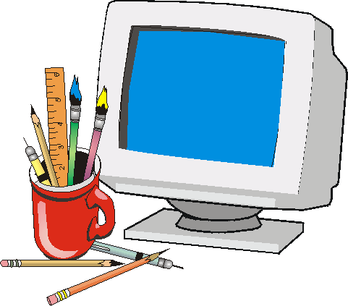
www.studymafia.org
Seminar
On
Computer Graphics
Submitted To: Submitted By:
www.studymafia.org www.studymafia.org
Notes:
1

Slide 2
Content
Introduction
History
What is Computer Graphics
Types
Application
Users
Advantages
Conclusion

Slide 3
Introduction
Computer graphics can be used in many disciplines.
Charting, Presentations, Drawing, Painting and Design, Image Processing and Scientific Visualization are some among them

Slide 4
History
The phrase “Computer Graphics” was coined in 1960 by William Fetter, a graphic designer for Boeing.
The field of computer graphics developed with the emergence of computer graphics hardware.

Slide 5
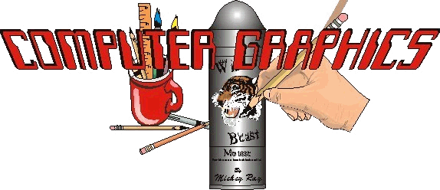
What is Computer Graphics?
Creation, Manipulation, and Storage of geometric objects (modelling) and their images (rendering)
Display those images on screens or hardcopy devices
Image processing
Others: GUI, Haptics,
Displays (VR)...

Slide 6
Types of Computer Graphics
Non Interactive Computer Graphics
Interactive Computer Graphics

Slide 7
Non Interactive Computer Graphics
It’s known as passive computer graphics, the observer has no control over the image.
Familiar examples of this type of computer graphics include the titles shown on TV and other forms of computer art.

Slide 8
Interactive Computer Graphics
Interactive Computer Graphics involves a two way communication between computer and user.
This helps him to signal his request to the computer.
The computer on receiving signals from the input device can modify the displayed picture appropriately.

Slide 9
Application
Paint programs
Illustration/design programs
Animation software
CAD software
Desktop publishing

Slide 10
Paint programs
The images are stored as bit maps and can easily be edited.
It is a graphics program that enables you to draw pictures on the display screen which is represented as bit maps (bit-mapped graphics).
In contrast, draw programs use vector graphics (object-oriented images), which scale better.

Slide 11
Illustration/design programs
Supports more advanced features than paint programs, particularly for drawing curved lines.
The images are usually stored in vector-based formats. Illustration/design programs are often called draw programs.

Slide 12
Animation software
It can be defined as a simulation of movement created by displaying a series of pictures, or frames.
A cartoon on television is one example of animation.

Slide 13
Desktop publishing
Provides a full set of word-processing features as well as fine control over placement of text and graphics, so that you can create newsletters, advertisements, books, and other types of documents.
It means by using a personal computer or workstation high-quality printed documents can be produced.

Slide 14
CAD software
It is the acronym for computer-aided design.
A CAD system is a combination of hardware and software that enables engineers and architects to design everything from furniture to airplanes.

Slide 15
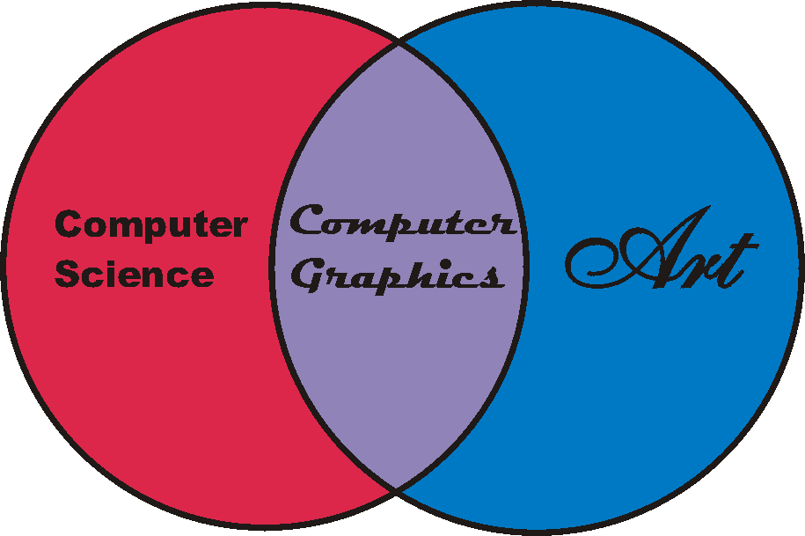
Uses
Entertainment and Advertising
Scientific Visualization
Industrial Design

Slide 16
ADVANTAGES
It’s have ability to show moving pictures and thus it is possible to produce animations with computer graphics.
The computer graphics also provides facility called update dynamics.

Slide 17
DISADVENTAGES
When it is not properly built, it can be very difficult to work with.
It generally requires more memory resources than a non-graphical one.
It might require the installation of additional software, e.g., the "runtime environment" in the case of java.

Slide 18
Conclusion
However as computer graphics went out of fashion when audiences became used to them, we see graphic designers using computers as they should be intended as another tool to get the required creative effect.

Slide 19
Thanks

